Slide 1

GOOGLE DATA ANALYTICS…
ANALYZING SMART DEVICE FITNESS DATA
Unlocking new Growth Opportunities for Bellabeat
Presented by
ANANDHASIVAM V S

Slide 2

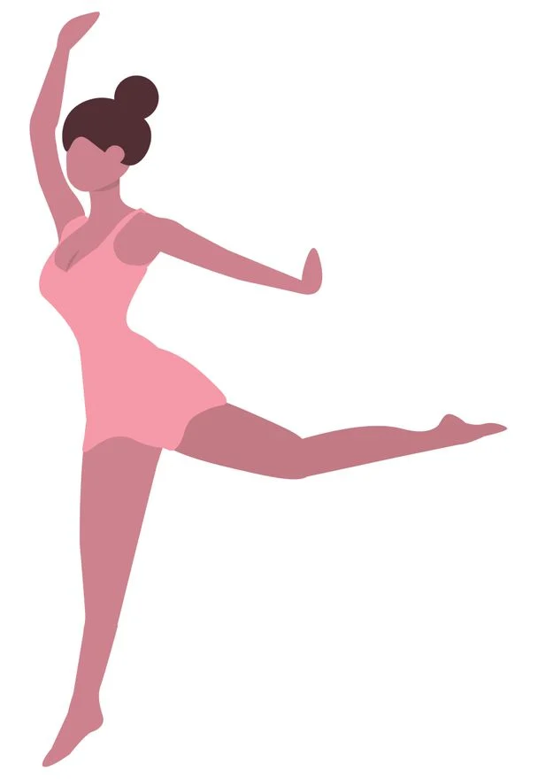
About Bellabeat
Bellabeat, a high-tech manufacturer of health-focused products for women.
They developed Leaf, Time, Spring and Bellabeat app to help the women's health and habits.
Bellabeat products became available through a growing number of online retailers in addition to their own e-commerce channel on their website.

Slide 3
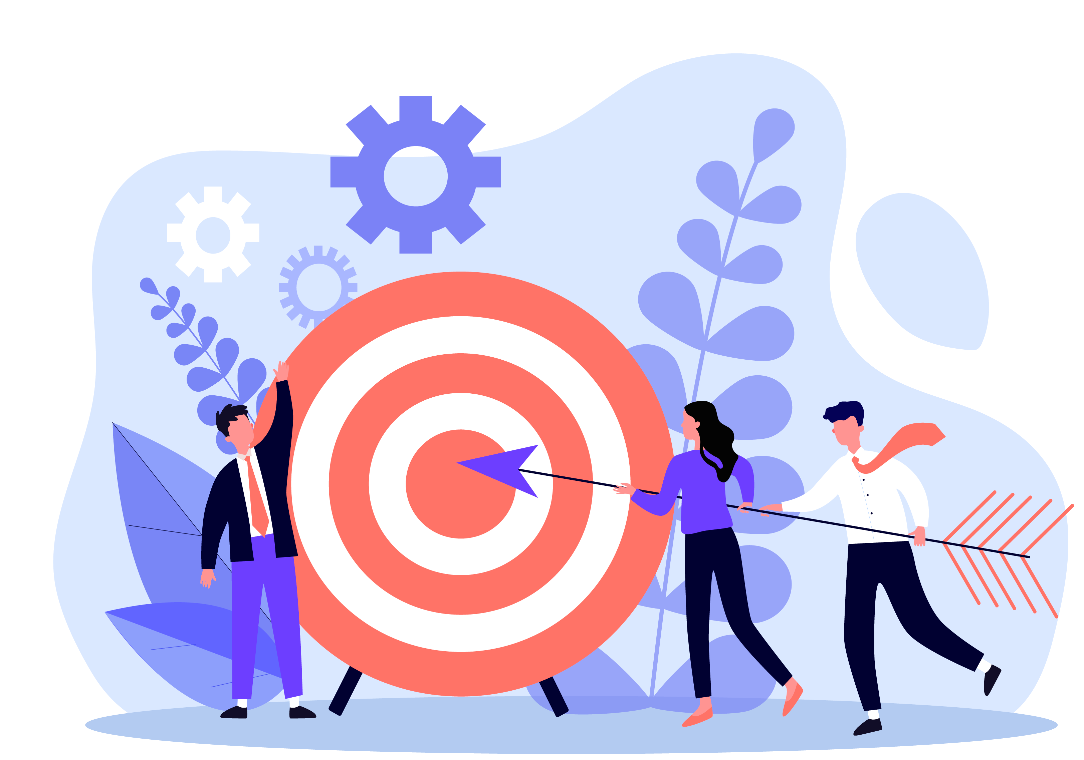
Main Objective
To analyze smart device usage data in order to gain insight into how consumers use non-Bellabeat smart devices like FitBit.
Gain the valuable insights and improve the products performance.

Slide 4
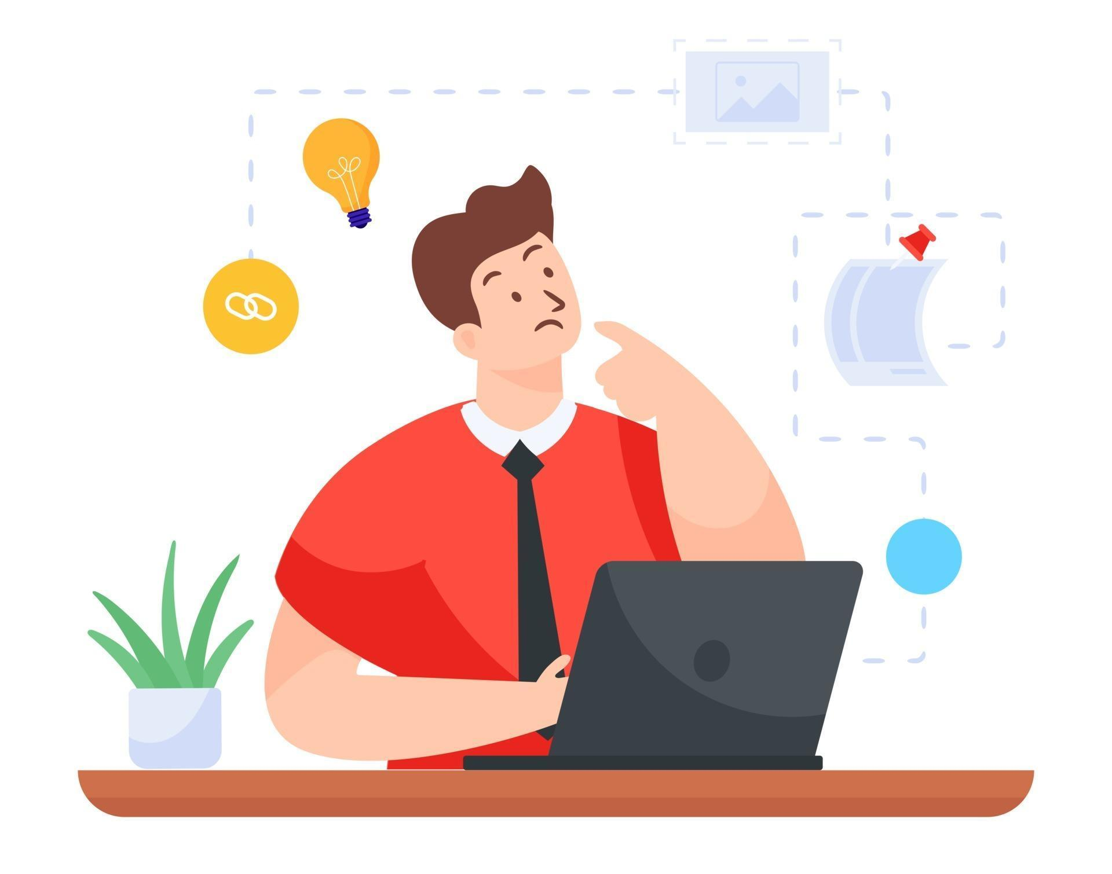
Main Task
Finding the popular and unpopular features of FitBit among the users.
Daily habit and routine of the users.
Utilizing the usage of the product for various needs.
Recommendations for Bellabeat’s marketing strategy.

Slide 5
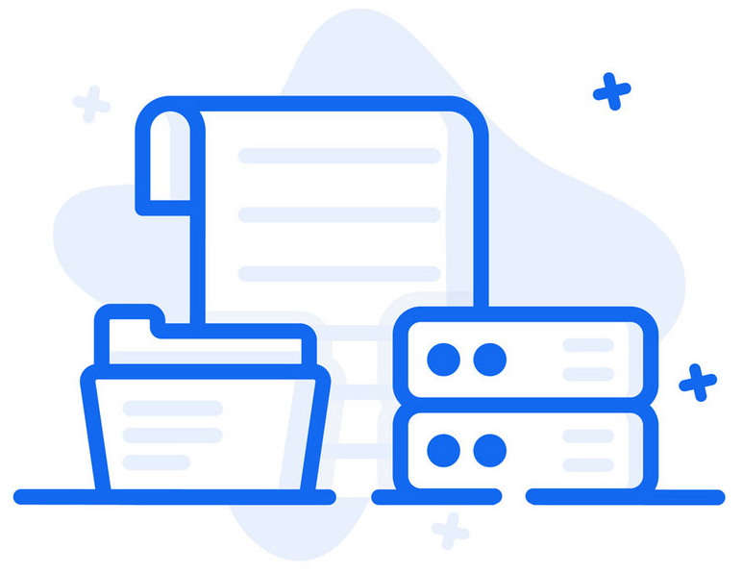
Data Source
The FitBit Users Dataset is available on Kaggle for open source.
The Dataset contains nearly 33 users data over a 3 months period.
Some tables are in the narrow and wide format for easily analysis.
Dataset Link - Kaggle

Slide 6
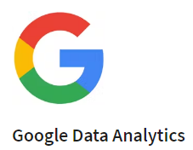


Approach
Steps of Data Analysis Process
Ask
Prepare
Process
Analyze
Share
Act

Slide 7
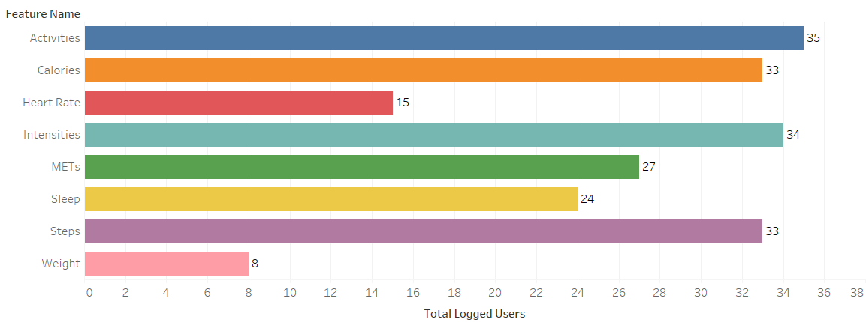
User Log Analysis
Compared with other features, the Weight and Heartrate features are relatively low logged users count.

Slide 8
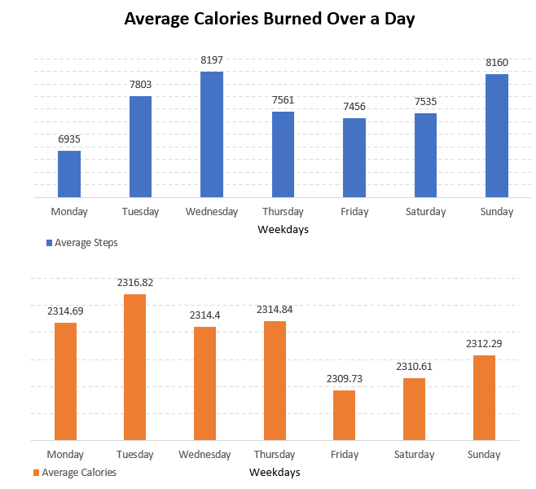
Average Steps Over a Week
Compared with other days, Monday have a low average step count but average calories burned nearly equal to other weekdays.
This is due to the users laziness.

Slide 9
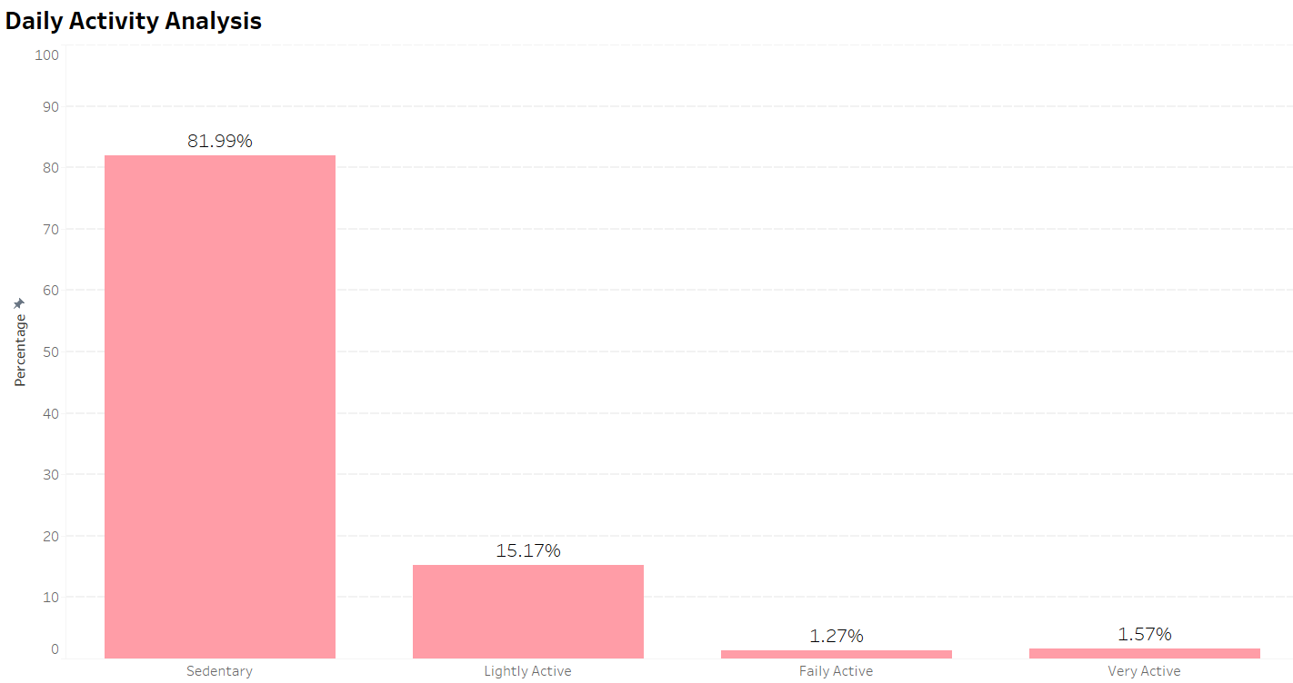
Daily Activity Analysis
The users uses the device to track their Sedentary activities (Daily routine).
Nearly 2% of the involving the activities like workouts and trainings.

Slide 10
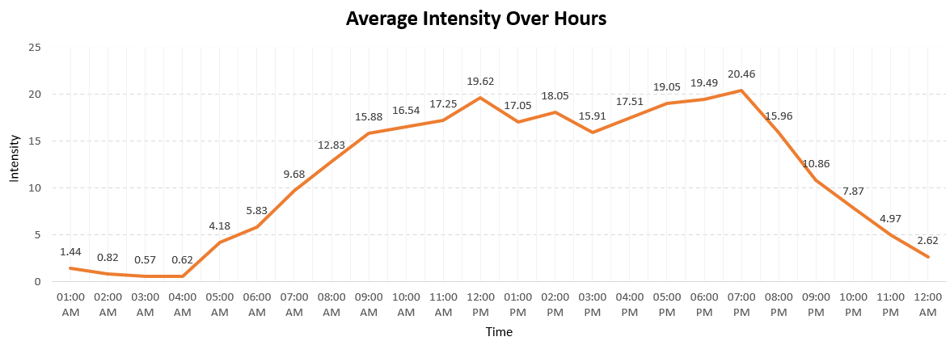
Intensity Analysis
The visual shows that there is no major peeks in the line.
Most of the FitBit users are working professionals, because morning 11:00 to evening 7:00 the intensity is high and nearly constant over that time.

Slide 11
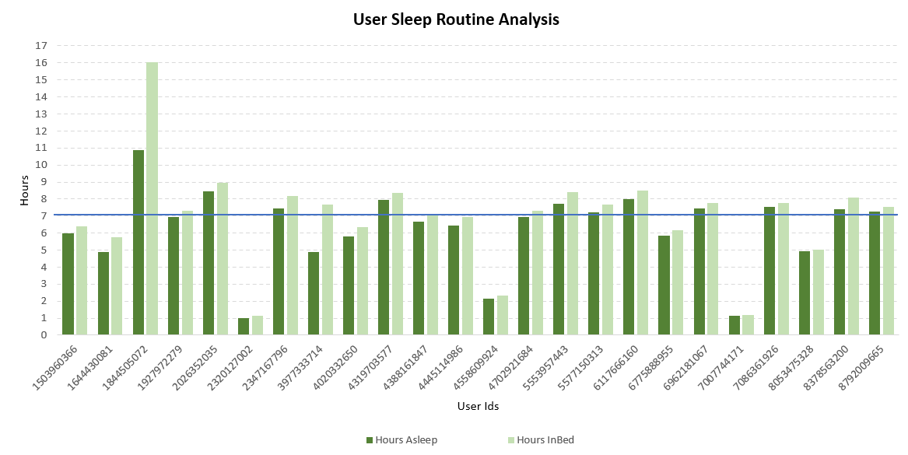
User’s Sleep Analysis
Some user not achieve the recommended sleep hour (7 hours a day).

Slide 12


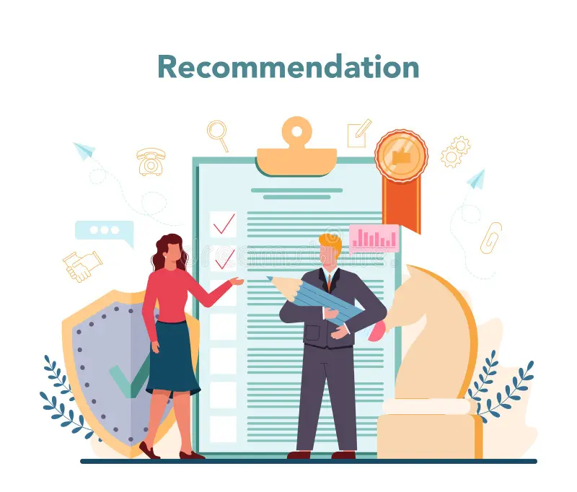
My Recommendations
Give a more precise Heartrate tracker for the users with app integration and daily reports.
Most of the users are working professionals, so they sometimes forgot to drink water and do exercises, push some remainder to overcome this.
The FitBit users mostly like to track the sedentary activities, based on that we can give the some additional features for tracking the workout and providing the detailed reports on the mobile apps.
Weekly or daily remind the users about their sleep routines and provide some recommendations based on their activities.

Slide 13
Thank You

